Slide 1
Bedrock Demo
Document Ingesting and Comparison

Slide 2
The program flow
Automation sends file s3
S3/Lambda Trigger calls function
Function calls bedrock model to OCR data into Json
Checks if record exists, inserts or updates
Function prompts model to compare data to db data if present
If loan number not found, then insert a record
When updating, if duplicate, adds new fields it finds
If loan found compare data from contract
Create report

Slide 3
Extraction prompt
Config-driven field list (DynamoDB)
PDF pages converted to images
Vision AI extracts structured JSON
Canonical field names, no duplicates
Handles handwritten / variant labels
Signature presence and premium-only rules for RIC forms
Notes:
Extraction Prompt – High Level
Purpose:Use AI vision (Bedrock/Claude) to read contract PDFs and pull structured JSON from form fields.Flow:Config-driven fields – Field list comes from DynamoDB (config per client/contract type).
PDF → Images – Each page is converted to PNG and sent to the vision model.
Main instructions:Extract all configured fields; use null if not found.
Use lowercase_with_underscores.
Use one canonical field per concept (e.g., VIN / vehicle ID / vehicle identification number → vin).
Do not duplicate the same value under different keys.
Output strict JSON only.
Special rules (e.g., sone / RIC forms):Application number – Handle variants like “app#”, “App No”, etc., especially when handwritten.
Signature fields – Mark true/false if a signature is present in that section.
Premium/currency – Extract only dollar amounts; do not put names or other text into premium fields.
Bullet-point version for slides:Config-driven field list (DynamoDB)
PDF pages converted to images
Vision AI extracts structured JSON
Canonical field names, no duplicates
Handles handwritten / variant labels
Signature presence and premium-only rules for RIC forms

Slide 4
Comparison prompt
Compares extracted document data vs. existing database record
Returns match (true/false) and list of differing fields
Normalizes before comparing: currency, dates, whitespace, case, placeholders, phones
Only flags real differences, not formatting differences
Notes:
Extraction Prompt – High Level
Purpose:Use AI vision (Bedrock/Claude) to read contract PDFs and pull structured JSON from form fields.Flow:Config-driven fields – Field list comes from DynamoDB (config per client/contract type).
PDF → Images – Each page is converted to PNG and sent to the vision model.
Main instructions:Extract all configured fields; use null if not found.
Use lowercase_with_underscores.
Use one canonical field per concept (e.g., VIN / vehicle ID / vehicle identification number → vin).
Do not duplicate the same value under different keys.
Output strict JSON only.
Special rules (e.g., sone / RIC forms):Application number – Handle variants like “app#”, “App No”, etc., especially when handwritten.
Signature fields – Mark true/false if a signature is present in that section.
Premium/currency – Extract only dollar amounts; do not put names or other text into premium fields.
Bullet-point version for slides:Config-driven field list (DynamoDB)
PDF pages converted to images
Vision AI extracts structured JSON
Canonical field names, no duplicates
Handles handwritten / variant labels
Signature presence and premium-only rules for RIC forms

Slide 5
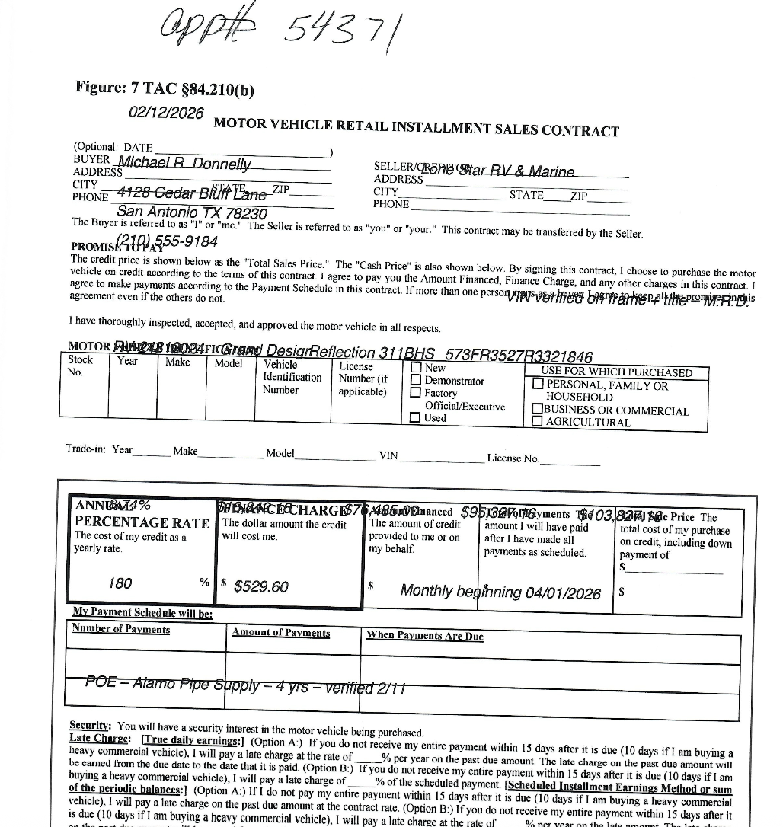
Sample Contract

Slide 6
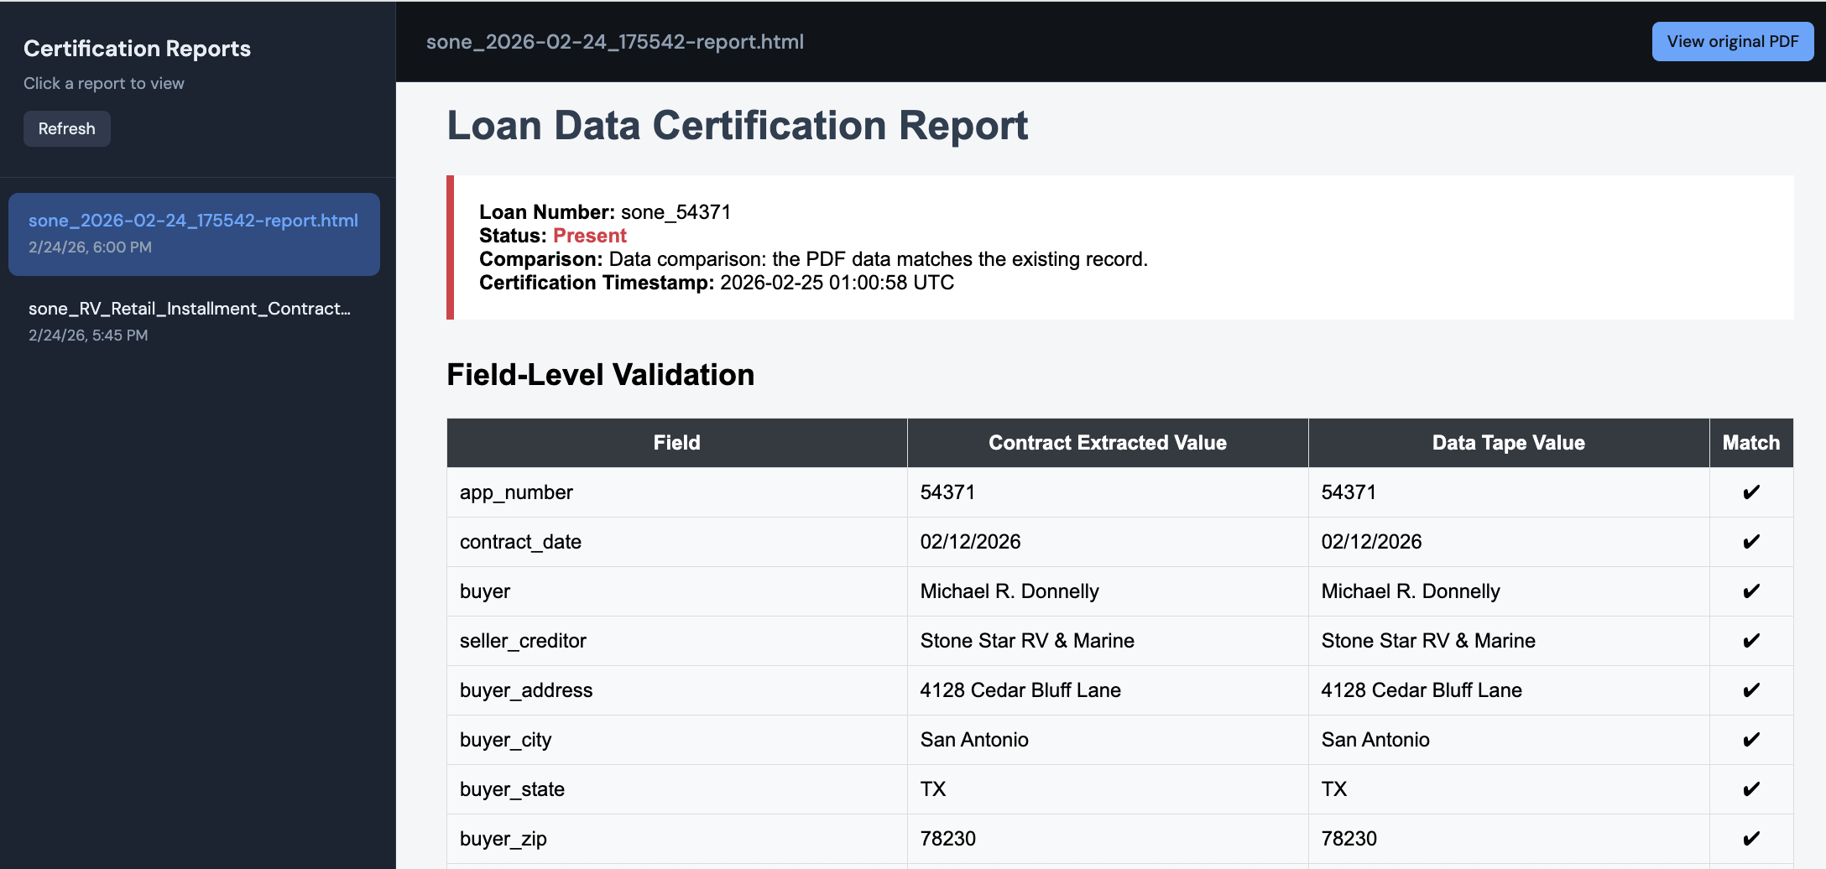
Sample Report Output (Insert/Update/Compare)

Slide 7
DynamoDB Table Record
Show table schema in viewer

Slide 8
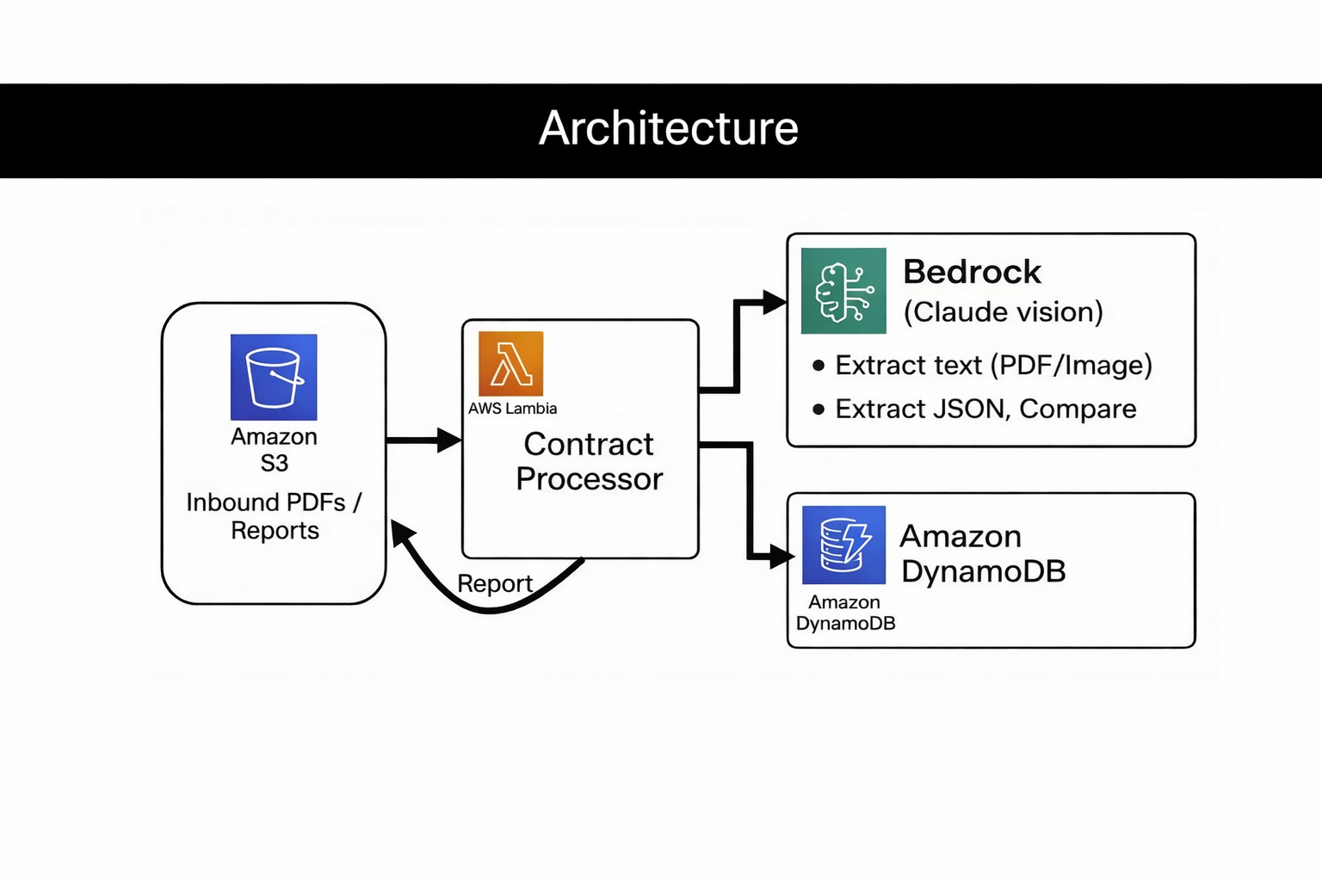

Slide 9
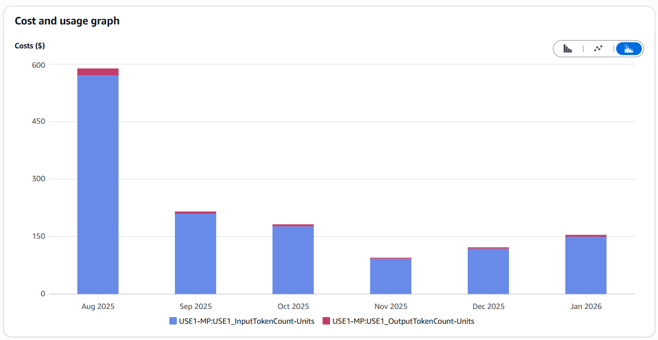
Cost estimates (from PCG AWS Account)

Slide 10
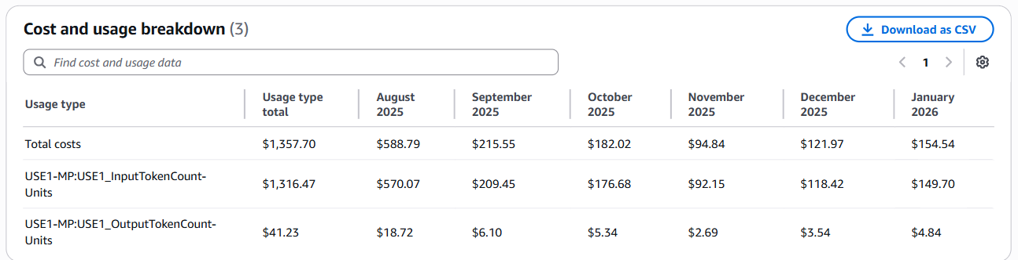
Cost estimates continued

